Slide 1


DevOps
Abishek S K

Slide 2

Agenda
Waterfall model
Agile model
DevOps
Azure DevOps

Slide 3


Introduction
DevOps is basically a combination of two words- Development and Operations. DevOps is a culture that implements the technology in order to promote collaboration between the developer team and the operations team to deploy code to production faster in an automated and repeatable way.

Slide 4

Waterfall Model

Slide 5
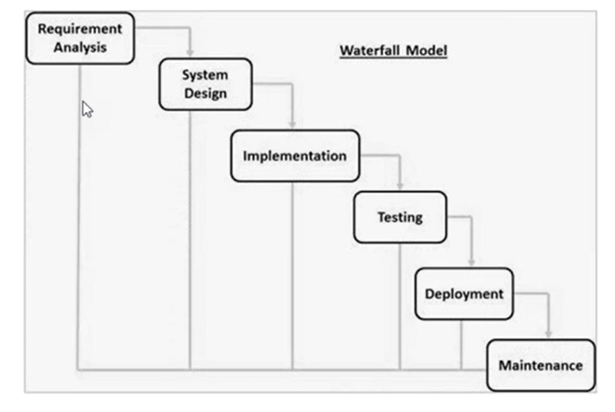
Waterfall Model
The waterfall model is a linear, sequential approach to the software development lifecycle (SDLC).

Slide 6
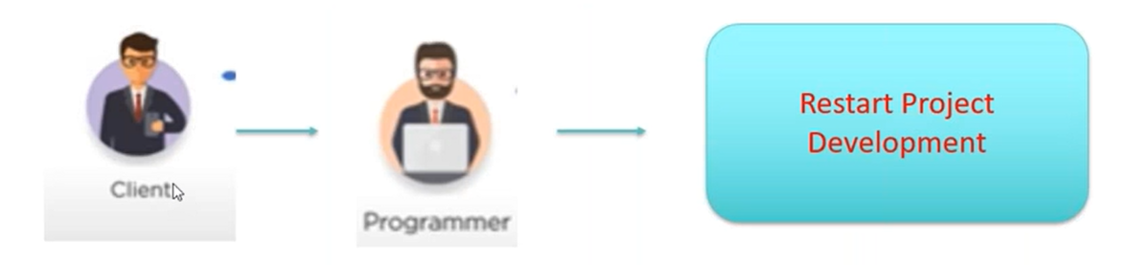
Waterfall Model Disadvantages
Any new requirement from the client will restart the development cycle.

Slide 7
Agile Model

Slide 8
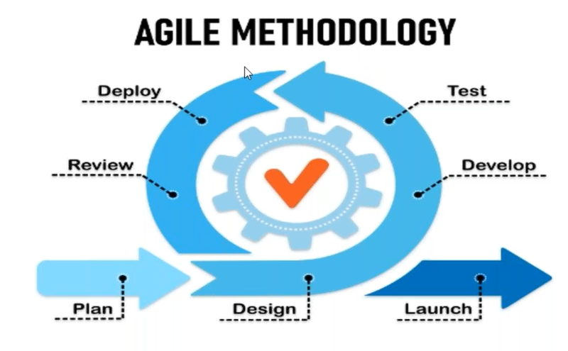
Agile Model
The Agile methodology is a project management approach that involves breaking the project into phases and emphasizes continuous collaboration and improvement.

Slide 9
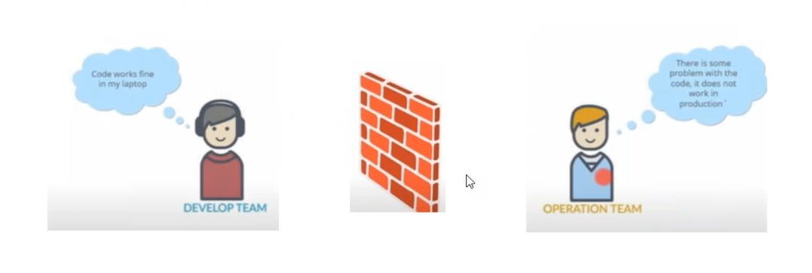
Agile Model Disadvantages
The flexibility at the core of the Agile method also means a much lower degree of predictability.

Slide 10
DevOps

Slide 11
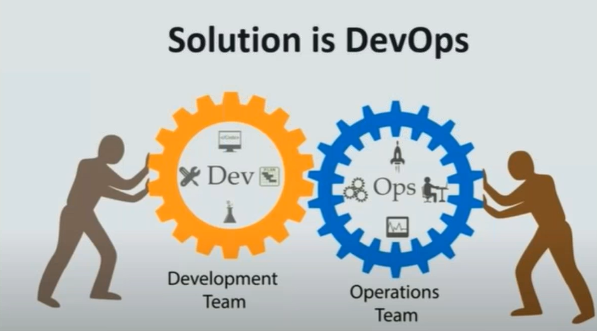
DevOps

Slide 12
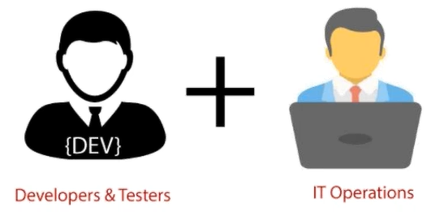
DevOps
The DevOps life cycle is working with two major parts, one is software Development, and second is Operations. This allows a single team to handle the entire application lifecycle, from development to testing, deployment, and operations. DevOps helps you to reduce the disconnection between software developers, quality assurance (QA) engineers, and system administrators.

Slide 13

DevOps

Slide 14

Git
Git is an open-source distributed version control system that is freely available for everyone. It is designed to handle minor to major projects with speed and efficiency. It is developed to co-ordinate the work among programmers. The version control allows you to track and work together with your team members at the same workspace. It is used as a critical distributed version-control for the DevOps tool.

Slide 15
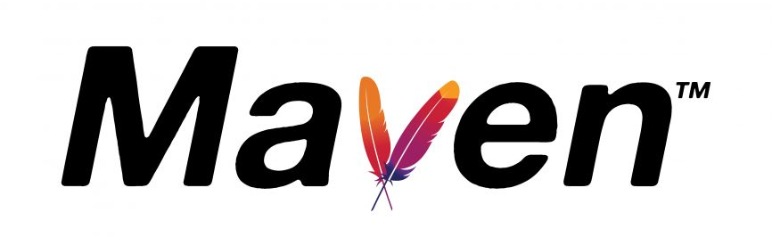
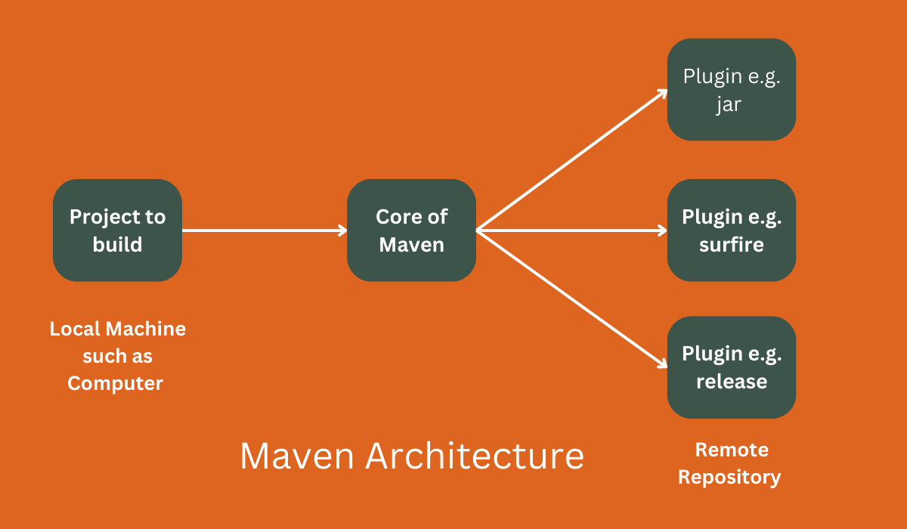
Maven
Maven is a project management and comprehension tool. Maven provides developers a complete build lifecycle framework. Development team can automate the project's build infrastructure in almost no time as Maven uses a standard directory layout and a default build lifecycle.

Slide 16

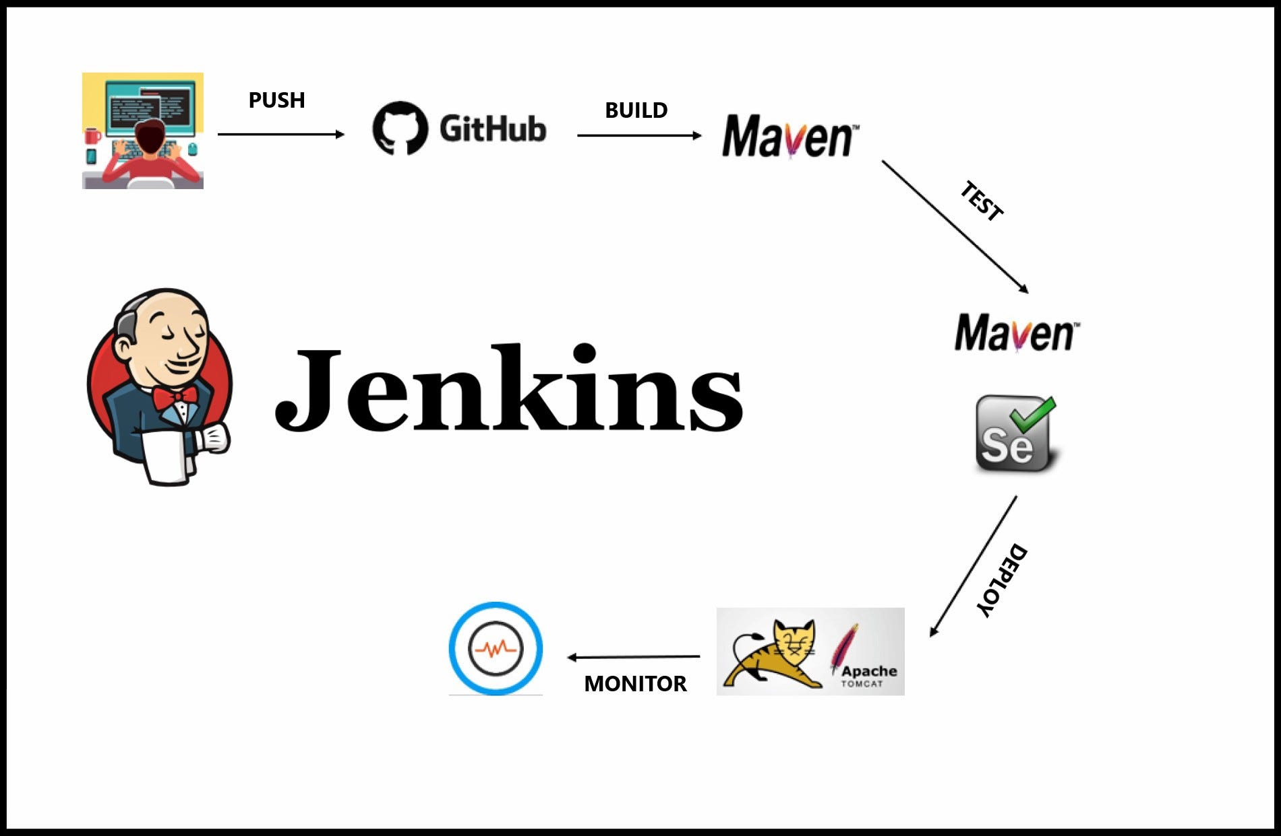
Jenkins
Jenkins is an open-source continuous integration/continuous delivery and deployment (CI/CD) automation software DevOps tool written in the Java Programming language. It is used to implement CI/CD workflows called pipelines.

Slide 17
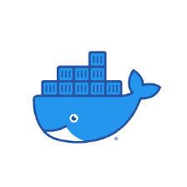
Docker
Docker is a platform for developing, shipping, and running applications. Docker enables you to separate your applications from your infrastructure so you can deliver software quickly. With Docker, you can manage your infrastructure in the same ways you manage your applications. By taking advantage of Docker's methodologies for shipping, testing, and deploying code quickly, you can significantly reduce the delay between writing code and running it in production.

Slide 18
Docker Container
A container is a running instance of an image. You can create, start, stop, move, or delete a container using the Docker API or CLI. You can connect a container to single or multiple networks, attach storage to it, or even create a new image based on its current state.
By default, a container is relatively well isolated from other containers and its host machine. You can control how isolated a container's network, storage, or other underlying subsystems are from other containers or from the host machine.

Slide 19
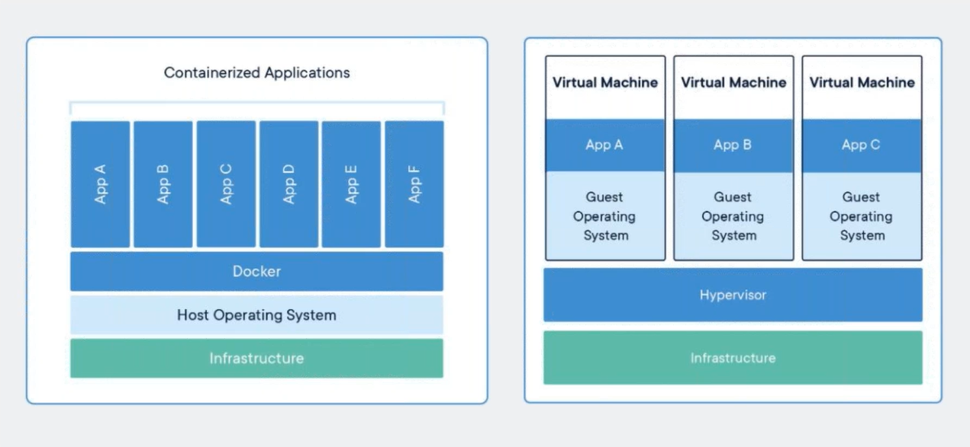
DevOps

Slide 20
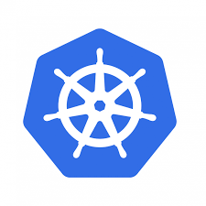
Kubernetes
Kubernetes or K8s was a project spun out of Google as an open source next-gen container scheduler designed with the lessons learned from developing and managing Borg and Omega.
Kubernetes was designed from the ground-up as a loosely coupled collection of components centered around deploying, maintaining, and scaling applications.

Slide 21
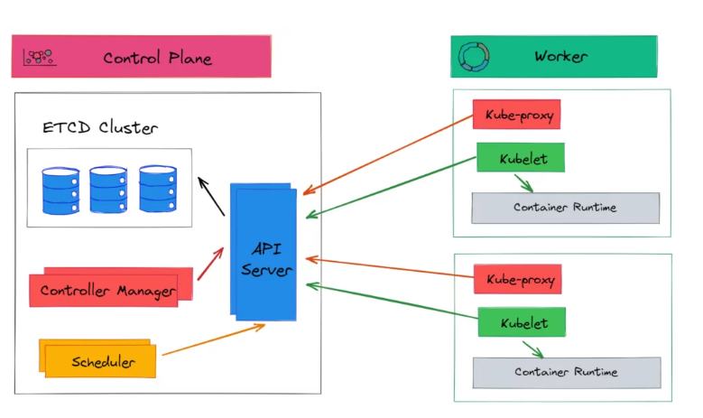
Kubernetes Architecture

Slide 22
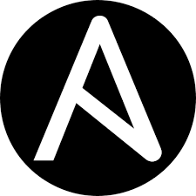
Ansible
Ansible is simple open-source IT engine which automates: application deployment, intra service orchestration, cloud provisioning and many other IT tools.
Ansible uses playbook to describe automation jobs, and playbook uses very simple language i.e. YAML
Ansible is designed for multi-tier deployment.
Ansible uses the hosts file where one can group the hosts & can control the actions on a specific group in the playbooks.

Slide 23
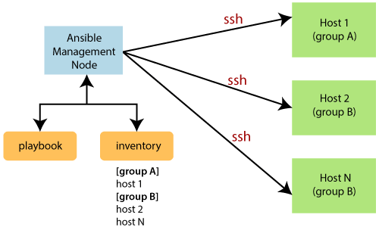
Ansible

Slide 24
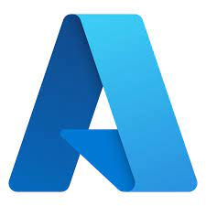
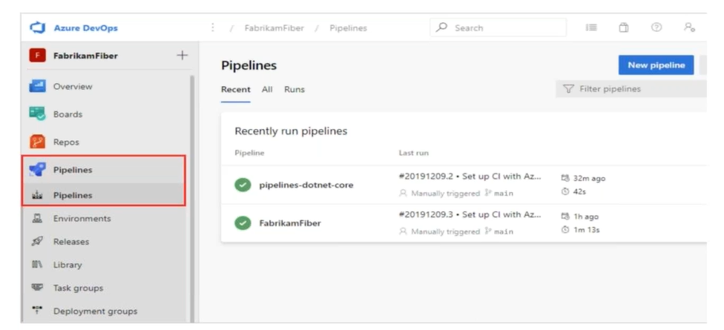
Azure DevOps pipeline
Azure Pipelines automatically builds and tests code projects. It supports all major languages and project types and combines continuous integration, continuous delivery, and continuous testing to build, test, and deliver your code to any destination.

Slide 25
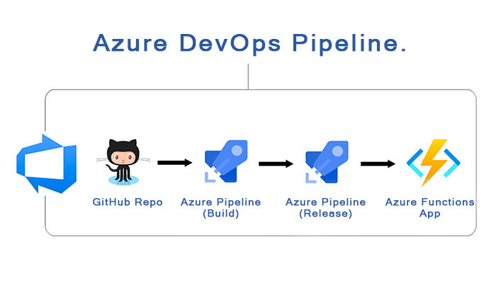
Azure DevOps

Slide 26
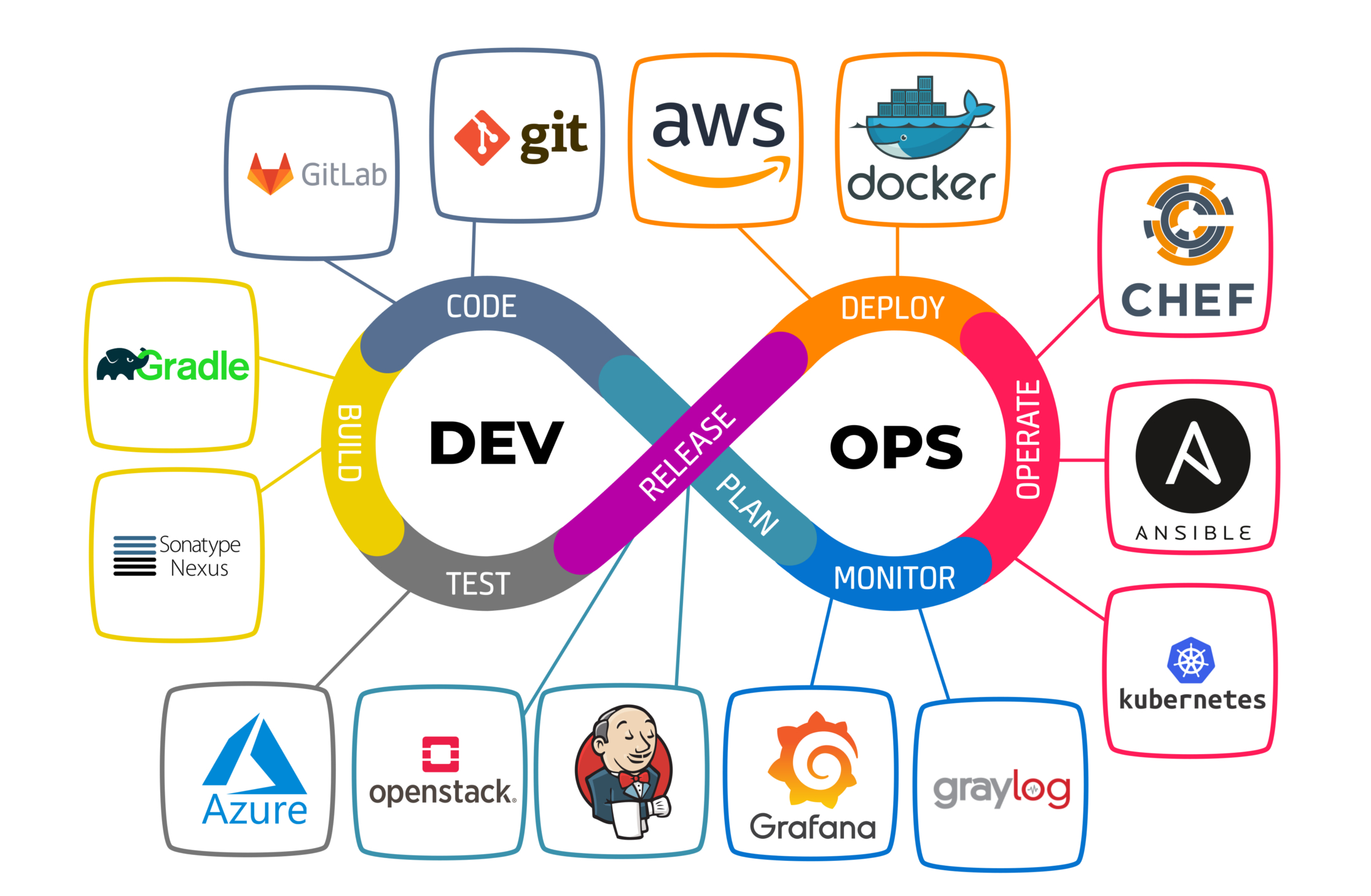
DevOps

Slide 27



Summary
DevOps is the combination of cultural philosophies, practices, and tools that increases an organization's ability to deliver applications and services at high velocity: evolving and improving products at a faster pace than organizations using traditional software development and infrastructure management processes.

Slide 28


THANK YOU
Abishek S K
abishek.sk@mphasis.com

